Slide 1
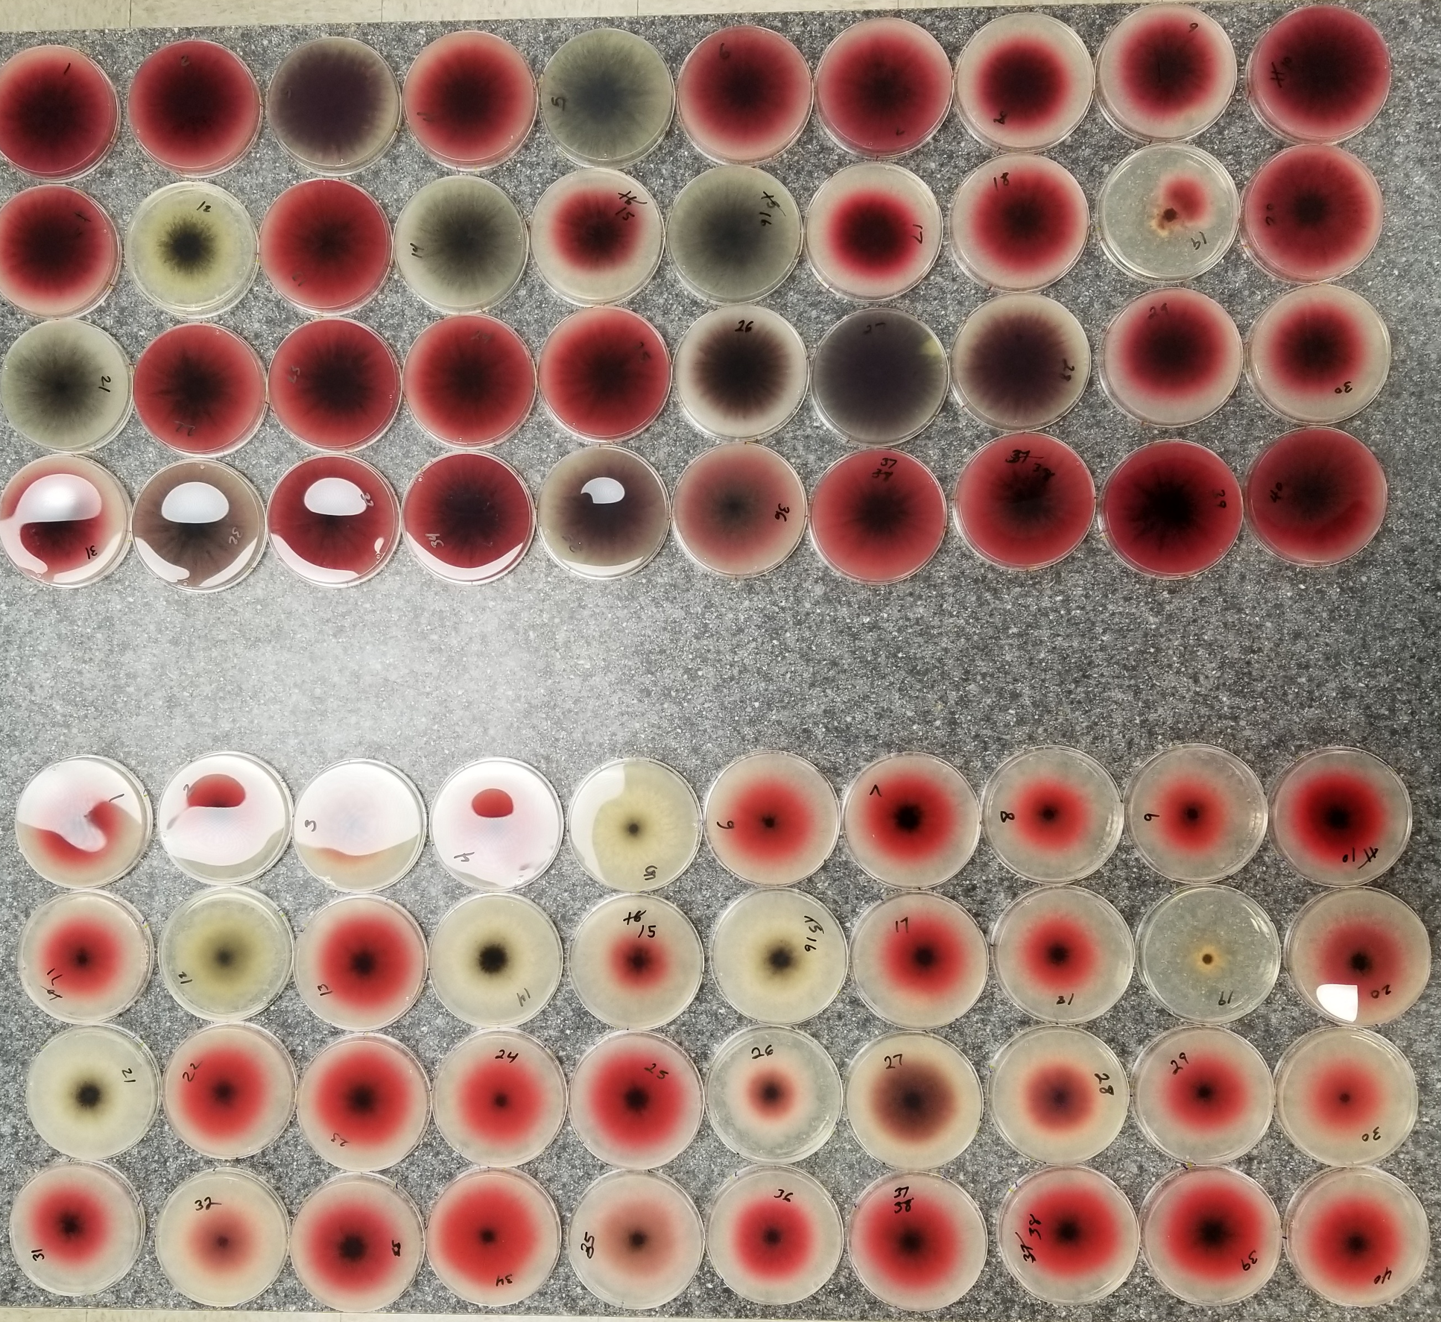
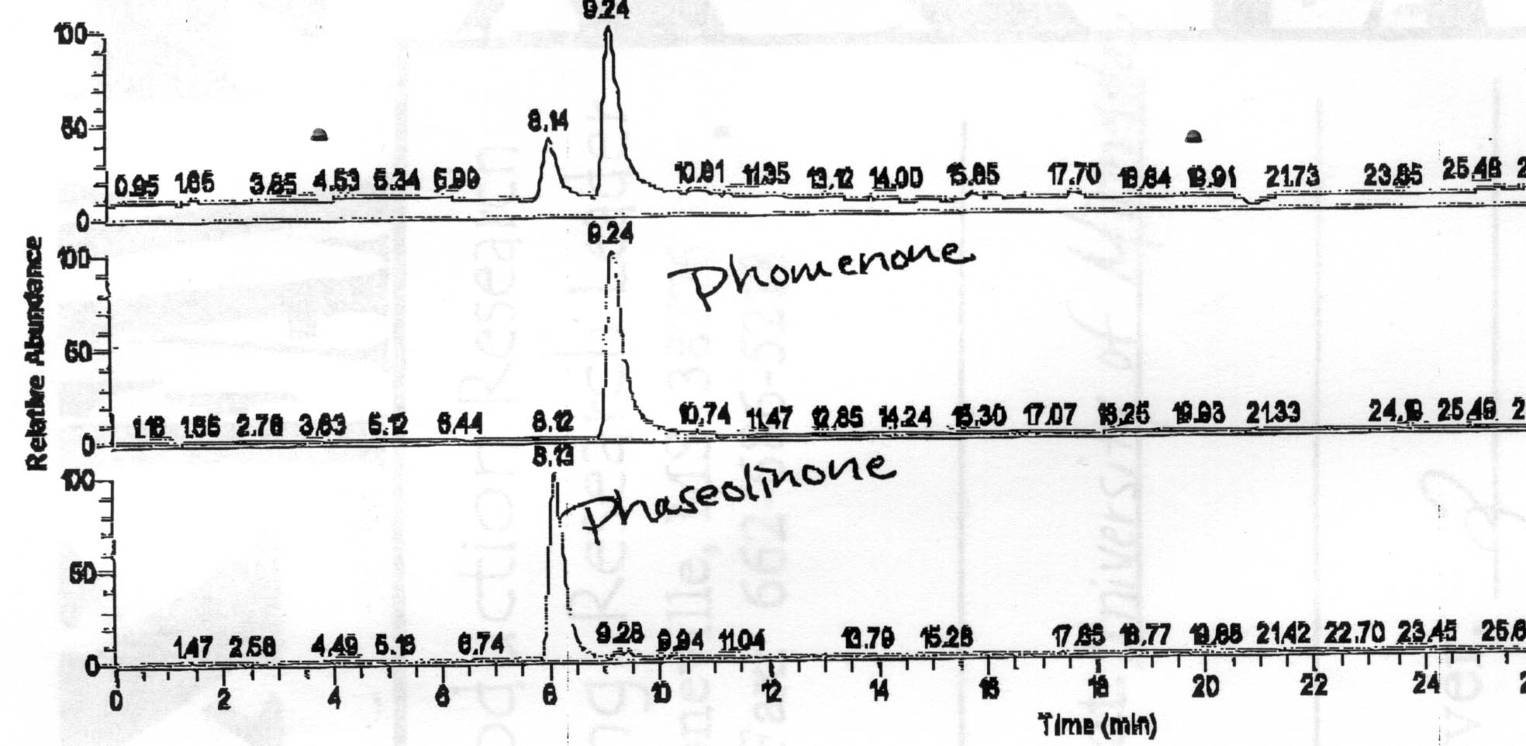
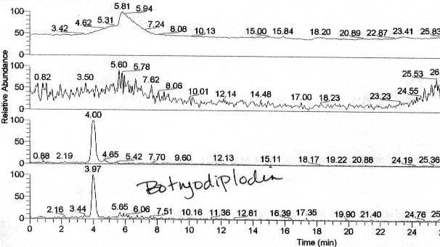
Rapid Screening for Production of the Mycotoxin Botryodiplodin by Isolates of the Charcoal Rot Disease Fungus, Macrophomina phaseolina, from Soybean and Strawberry
Vivek Khambhati¹, Hamed K. Abbas¹, W. Thomas Shier², Natalia A. Peres³, Jeremy K. Kotowicz¹, Nacer Bellaloui⁴, and Tom Allen⁵
¹USDA-ARS, Biological Control of Pests Res. Unit, Stoneville, MS; ²College of Pharmacy, Univ. of Minnesota, Minneapolis, MN; ³Gulf Coast Res. Education
Center, Univ. of Florida, Wimauma, FL; ⁴USDA-ARS, Crop Genetics Res. Unit, Stoneville, MS; and ⁵Delta Res. & Extension Center, MS Univ., Stoneville, MS
Abstract: Macrophomina phaseolina (Tassi) Goidanich is a fungal pathogen, which affects wide varieties of plant species, causing many diseases that significantly reduce crop yield, such as charcoal rot, crown and root rot, wilt, and others. M. phaseolina produces several mycotoxins, including phomenone, phaseolinone, patulin, and (±)-botryodiplodin, which are assumed to play a role in the host infection process. Mycotoxin botryodiplodin has been observed to exhibit many phytotoxic properties and is suspected to create a necrotic region and allow the fungus to penetrate the host. In vitro botryodiplodin has been previously observed to react with protein to produce pink to dark red pigmentation within 30 minutes. Studies relating to (±)-botryodiplodin have been slowed by the lack of commercially available standard and the difficulty of chemical synthesis. Our study focused on screening 50 isolates recovered from Mississippi soybean (Glycine max L.) and Florida strawberry (Fragaria spp.) with symptoms of charcoal rot disease, and detecting substantial production of botryodiplodin using a Czapek-Dox Agar medium modified with 10 g/L glycine and incubating for 2-7 days. Isolates containing a significant amount of botryodiplodin produced pink to dark red pigment, and atoxigenic isolates did not produce any color. The screening process resulted in 90% of the isolates producing varying shades red pigmentation with the remaining producing no pigment. Isolates producing a strong pigment were transferred to Czapek-Dox broth, and after incubation, the toxins were extracted and analyzed. LC/MS analysis detected a range of 0.9-6.1 ppm of botryodiplodin and 0-106 ppm of phaseolinone produced by the isolates. An isolate meeting the criteria of 1) high production of (±)-botryodiplodin and 2) little to no production of other mycotoxins was selected for biosynthetic production of pure standard (±)-botryodiplodin for use in further research.
Positive and negative results from CDA glycine plates (LEFT) (±)-botryodiplodin placed in glycine solution and incubated at room temperature overnight. (RIGHT)
Method: M. phaseolina isolates were maintained on potato dextrose agar (PDA). Two 5 mm plugs from each isolate were punched to inoculate two Petri dishes, one containing Czapek-Dox Agar (CDA) medium and the other CDA medium modified with 10 g/L glycine (Glycine), and incubated at 28°C for 7 days. Recorded daily for 7 days, the mycelial growth and pigment production diameters were measured by a ruler while the pigment intensity of the glycine plates were rated on a scale from 0-10 starting from no color and ending at dark red. After 7 days, three 5 mm plugs were removed from the CDA plates and transferred to a 96-well plate. The plate was covered and frozen overnight at -20°C. Next day, the plate was thawed to room temperature, and 120 µL of ethyl acetate was added to each well. The agar plugs were squeezed into the solvent with a glass rod, and 100 µL of the supernatant liquid was transferred to microcentrifuge tubes and dried. Each sample was reconstituted with 1 mL of ethyl acetate and analyzed by LC/MS.
Czapek-Dox Broth (CDB) medium was used to grow selected isolates in liquid media. 300 mL Erlenmeyer flasks were filled with 125 mL CDB and inoculated with 5 mm plugs from isolates on PDA. The flasks were incubated on a 110 rpm rotary shaker at 28°C for 7 days. After incubation, the broth was filtered with cheesecloth and 0.20 µm Millipore filter vacuum flask to obtain a cell-free filtrate. The toxins from the filtrate were extracted by adding 30 g/L activated charcoal and shaking for 1 hour. The charcoal was separated by centrifuge at 10,000 pm., dried, and eluted with CHCl₃ until no more color was removed. The eluate was dried, and the residue was reconstituted in 1 mL ethyl acetate and analyzed for toxins by LC/MS.
LC/MS analysis used a mobile phase mixture of acetic acid-water-methanol, and the concentrations of botryodiplodin and phaseolinone were calculated using a regression curve from a standard.
LC/MS analysis of phomenone, phaseolinone, and botryodiplodin
Results and Discussion: Isolates that produced a pink to red color were marked as positive for the glycine test, and isolates that produced no color were marked as negative. After 2 days of incubation, 50% of the isolates were found to be positive, after 3 days, 70% of the isolates were found to positive, and after 7 days, 90% of the isolates were found to be positive but produced varying shades of red pigment. The final pigment intensities of the positive isolates ranged from 4-10 of which only 20% had a rating ≤6. Due to some isolates taking as long as 6 days to produce a pigment, a 7 day incubation period is necessary to obtain definitive results from the glycine test. Concentrations for botryodiplodin and phaseolinone after incubation were calculated by LC/MS analysis of the plugs and cell-free extracts using the toxin standards. Isolates that produced no pigmentation were observed to have little to no botryodiplodin and some phaseolinone detected while isolates that produced pigmentation were detected to have between 0.9-6.1 ppm of botryodiplodin and 0-106 ppm of phaseolinone. The pigment intensities were compared to the LC/MS toxin concentrations, but no direct correlation was found between the two.
Conclusion: LC/MS analysis confirmed the presence of botryodiplodin in the isolates that produced a pigment on the glycine plates. However, the screening process can only be used as a qualitative in-culture assay because no direct correlation was found between the pigment intensity and toxin concentration. Further improvement on the method is needed to assess the sensitivity and validity of the glycine test.
Acknowledgements: The authors of this project would like to thank the Mississippi Soybean Promotion Board for financial support.
Proposed reaction mechanism between botryodiplodin and amino derivatives resulting in red pigmentation.

